Slide 1
Livewire Modal
박 성 철
scpark@yju.ac.kr

Slide 2
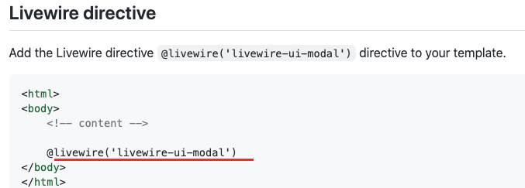
https://github.com/livewire-ui/modal
설치
composer require livewire-ui/modal

Slide 3
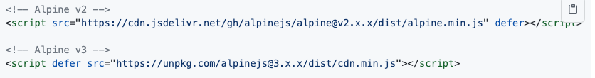
Livewire는 Alpine을 필요로 한다. 공식 CDN 사용하면 됨
TailwindCSS
php artisan vendor:publish --tag=livewire-ui-modal-views
모달 생성
php artisan make:livewire EditComment
ModalComponent 상속

Slide 4
https://tailwindcomponents.com/component/modal-3

Slide 5
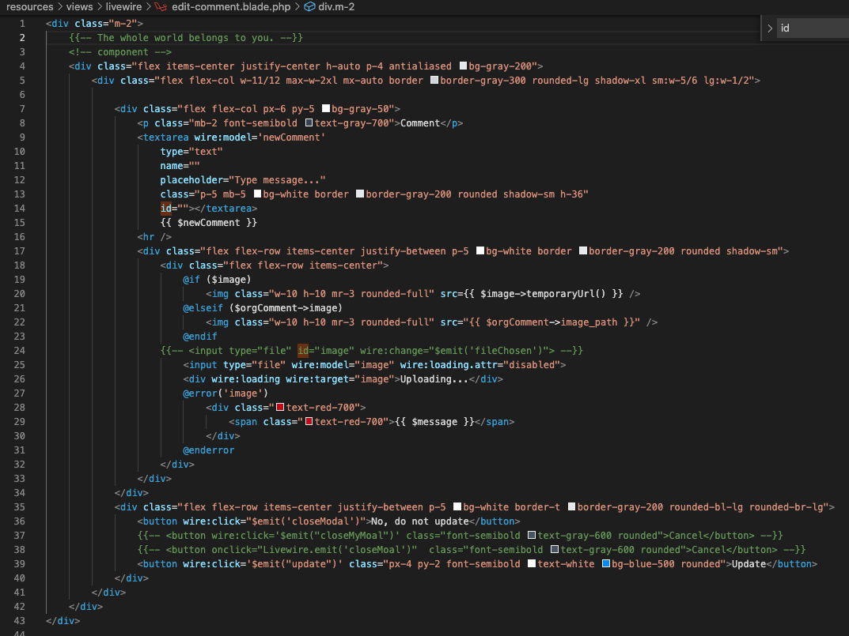

Slide 6
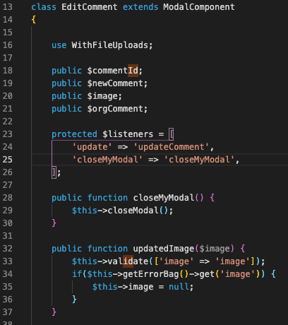
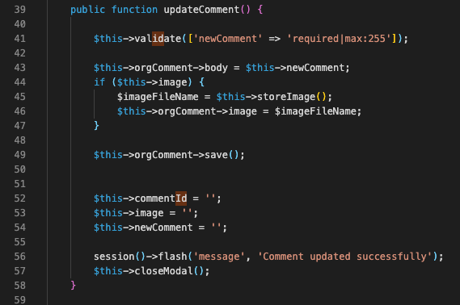

Slide 7
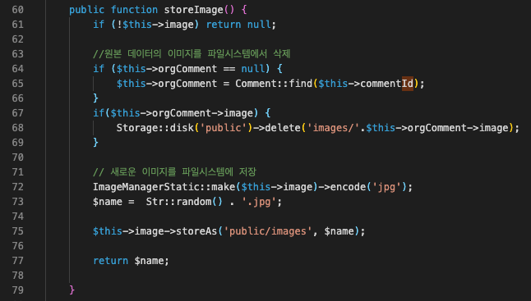

Slide 8
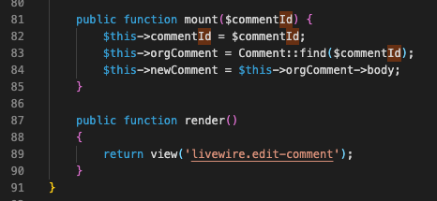
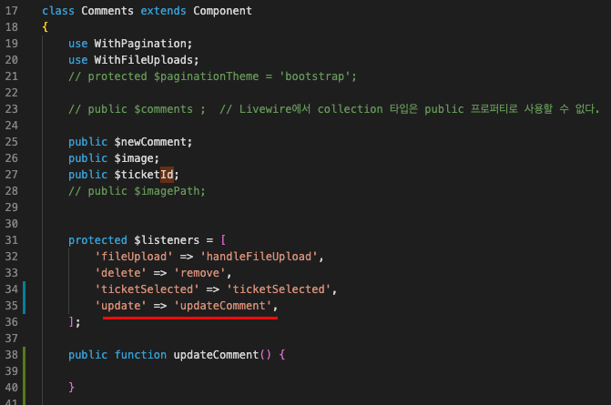

Slide 9
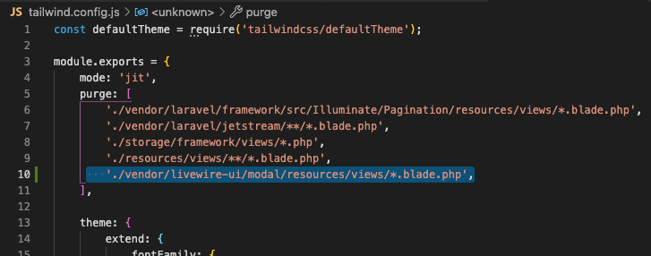
Building Tailwind CSS for production
To purge the classes used by the package, add the following lines to your purge array in tailwind.config.js:

Slide 10
